Slide 1
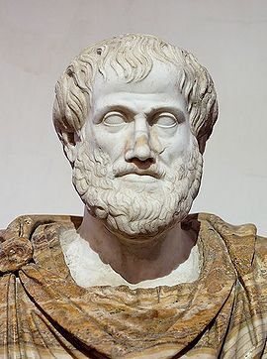
Aristotle 384 BCE – 322 BCE

Slide 2
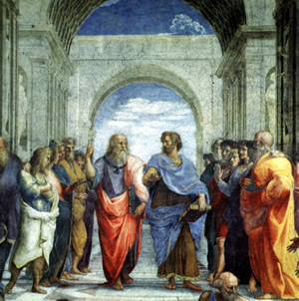
Aristotle is taught by Plato:
He favours the concrete over Platos’ interest in the abstract.

Slide 3
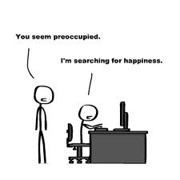
Aristotle teaches that happiness is the goal of life.

Slide 4
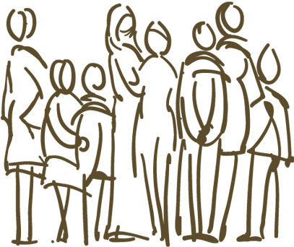
Happiness is found in community (the Polis or city state) according to Aristotle. Family is the basic unit of the Polis.

Slide 5
Aristotle’s Teleological Ethics
Aristotle teaches that everything has a ‘telos’ or purpose. We achieve happiness by developing our potential and striving to achieve our telos.

Slide 6
Happiness is different from pleasure. Pleasure is momentary, happiness is enduring (even if there are unpleasant moments).

Slide 7
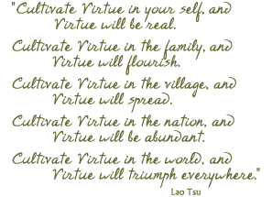
Happiness is found by cultivating or practicing virtues. These are habits of excellence.

Slide 8
Catholic Virtues:

Slide 9
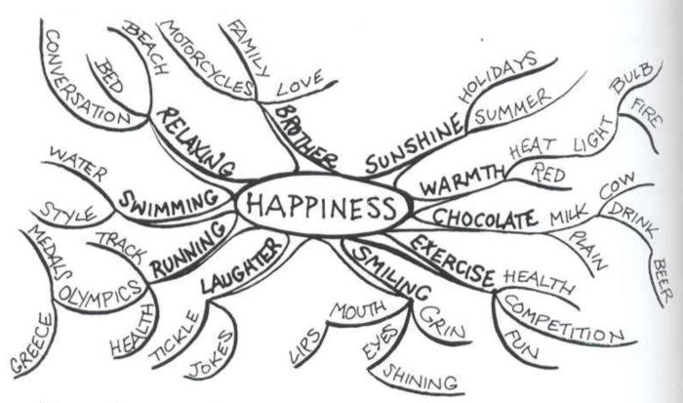
Do all things in moderation.
Practice the Golden Mean.

Slide 10
Aristotle said God is a perfect being who moves the world through love.

