Slide 1
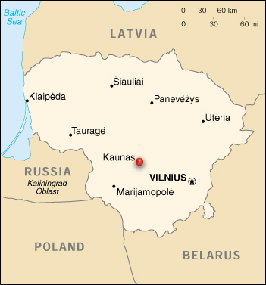
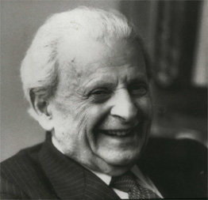
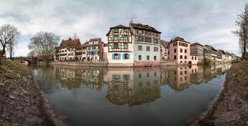
Emmanuel Levinas: An Ethics of the Face
Born in Kaunas, Lithuania, which at the time had about 32 000 Jews and 40 synagogues. Today only one synagogue remains and about 500 Jews.
1905-1995
At 17, he went to the University of Strasbourg
Synagogue in Kaunas

Slide 2
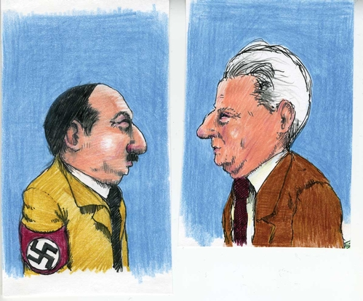
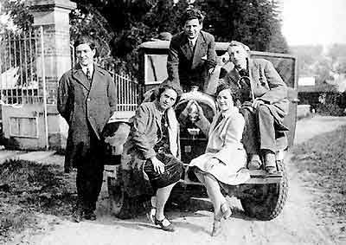
1930s and 1940s
Levinas studied philosophy, and spoke French, German, Russian and Hebrew.
He wrote a book criticizing Hitler in the 1930s.
Levinas, center, with best friend philosopher Maurice Blanchot on right.

Slide 3
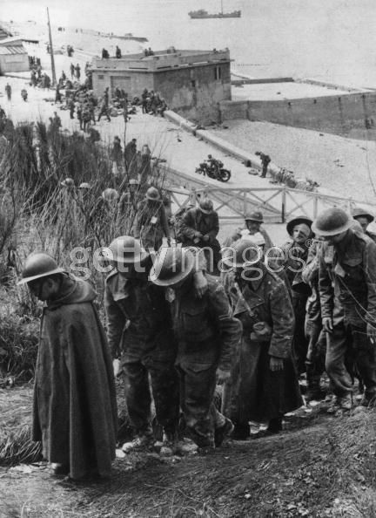
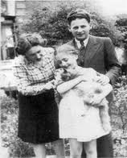
Levinas became a French soldier at the start of WWII but was captured early on and spent most of the war in a POW camp.
Levinas’ wife and daughter survived WWII thanks to Blanchot who found a hiding place for them in a Catholic Monastery.

Slide 4
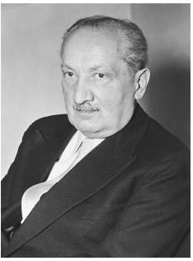
Levinas and Heidegger
Before the war, Levinas studied under German philosopher Martin Heidegger (left), but broke from his philosophy of being when Heidegger became a Nazi.

Slide 5
Western philosophers like Heidegger ask questions like: Do I exist? What is my purpose? They assume we are all the same. Difference is accidental. This sameness is called ‘Being’ or ‘Totality’.

Slide 6
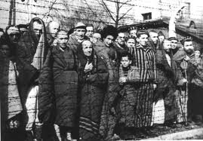
Levinas felt that Auschwitz showed that this understanding of humanity didn’t work.
If we’re all the same, what do you do with those who are different?

Slide 7
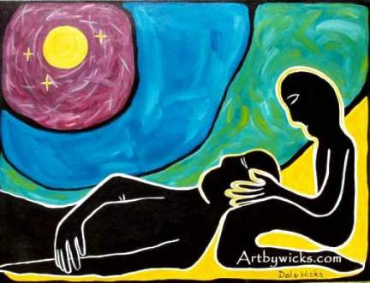
Levinas emphasized the ‘Wisdom of Love’ over the ‘Love of Wisdom’ (philosophy by definition).
Love means to take responsibility for the Other.

Slide 8
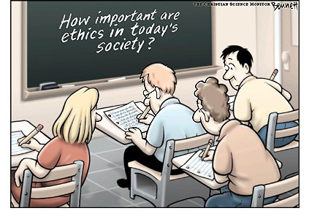
Levinas felt the only philosophy worth studying was ethics. Our responsibility for others is what matters.
Levinas said the ‘Good’ is the central question of all philosophy. “The Good is interested, not in what is common among things but what is absolutely unique.” (Textbook, 18)
“Ethics as First Philosophy”

Slide 9
Totality Vs. Infinity
Levinas contrasted the Western notion of totality against the Hebrew notion of infinity.
Totality: We are all the same.
Infinity: We are all different. And we are all responsible for each other.

Slide 10
Levinas’ most famous work is called Totality and Infinity.

Slide 11
A Trace of God
Because we are all unique and different, we each reflect a unique trace of our infinite God. We don’t see God in the face of another but we see a trace of God, a reflection, like sunlight on water.

Slide 12
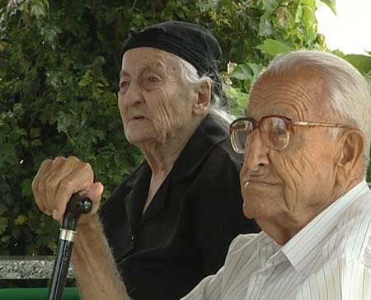
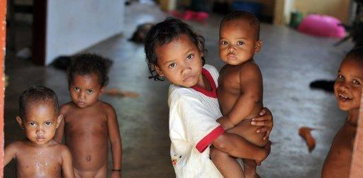
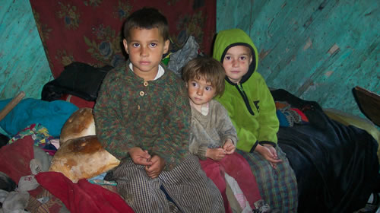
The face of another (the Other) compels us to take responsibility for them.

Slide 13
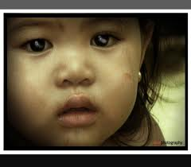
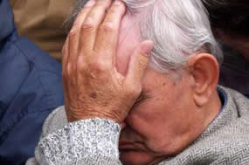
The face of the Other teaches us that we are not innocent. We are in fact responsible for each other.
We can only reach for God by reaching for the Other.
‘I-thou-Thou’

Slide 14
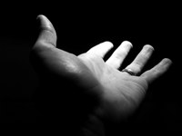
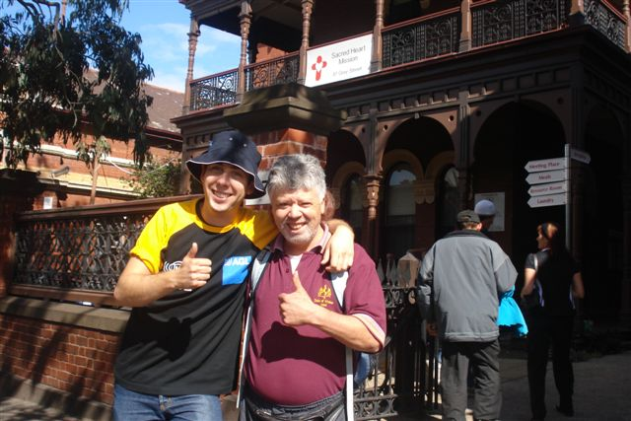
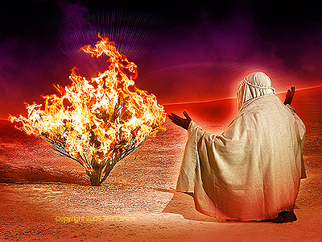
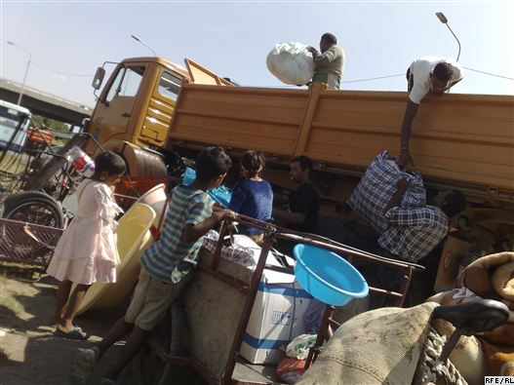
“Here I Am”, said to another person is more important than “I believe in God.”

